Slide 1
Modern Windows Development with .NET

Slide 2


Michael Hawker
Roy MacLachlan
Software Engineer
Product Manager

Slide 3


Slide 4






The Team
WSL
WinGet
Terminal
PowerToys
Windows ML
Windows AI APIs
And much more
Windows App SDK
WinUI

Slide 5
Table of contents
01
Modern Windows Development
02
WinUI Open Source Journey
03
AI for everyone w/ AI Dev Gallery
04
Microsoft Foundry Local
05
WinAppSdk updates

Slide 6
01
Modern Windows Development

Slide 7
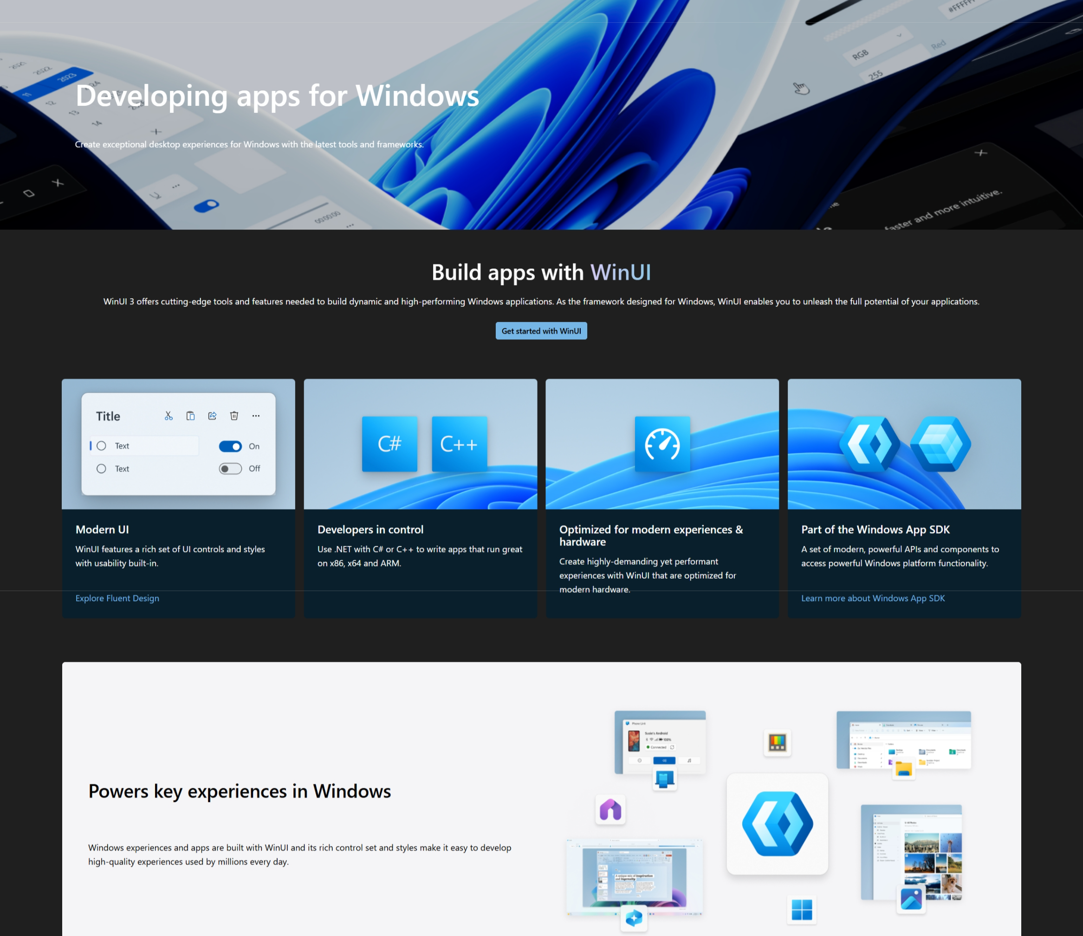
Microsoft Learn
http://aka.ms/windev

Slide 8
02
WinUI Open Source Journey

Slide 9
Open Sourcing WinUI
Rationale
Enable true community collaboration
Increase transparency
Accelerate innovation
Benefits
Reducing friction: developers can inspect, debug, and even contribute fixes
Improving agility: faster resolution of bugs and feature gaps
Strengthening collaboration: commitment to transparency

Slide 10
Open Sourcing WinUI
Test and Contribute
[February]
Repo Sync [October]
✅
⌛
📝
📝
[November] Locally Buildable
[future] Central to GitHub

Slide 11
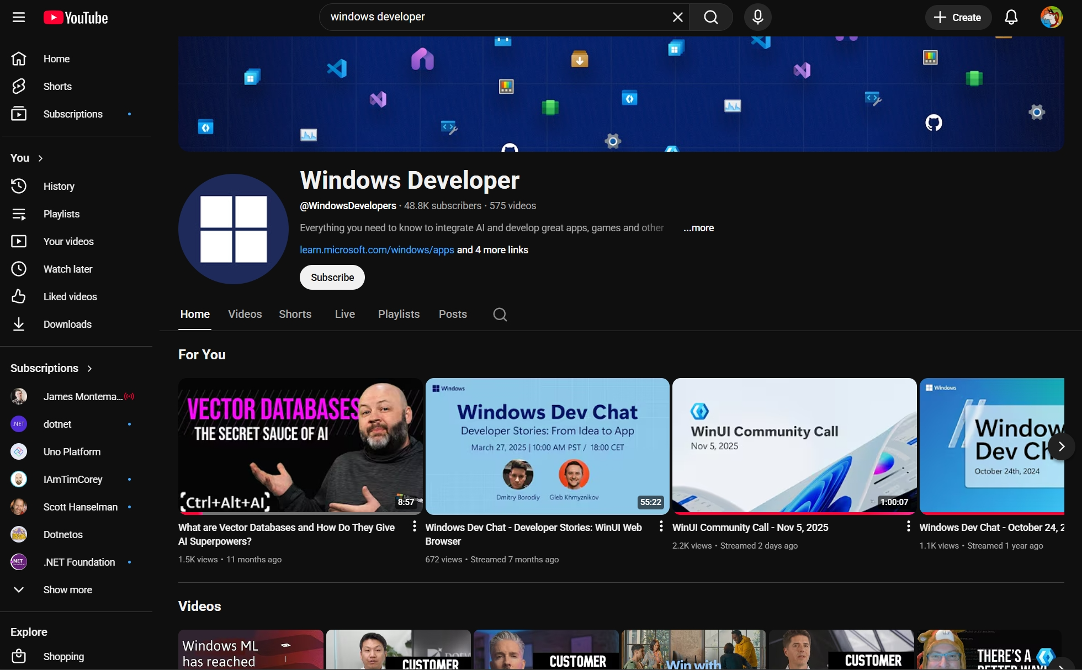
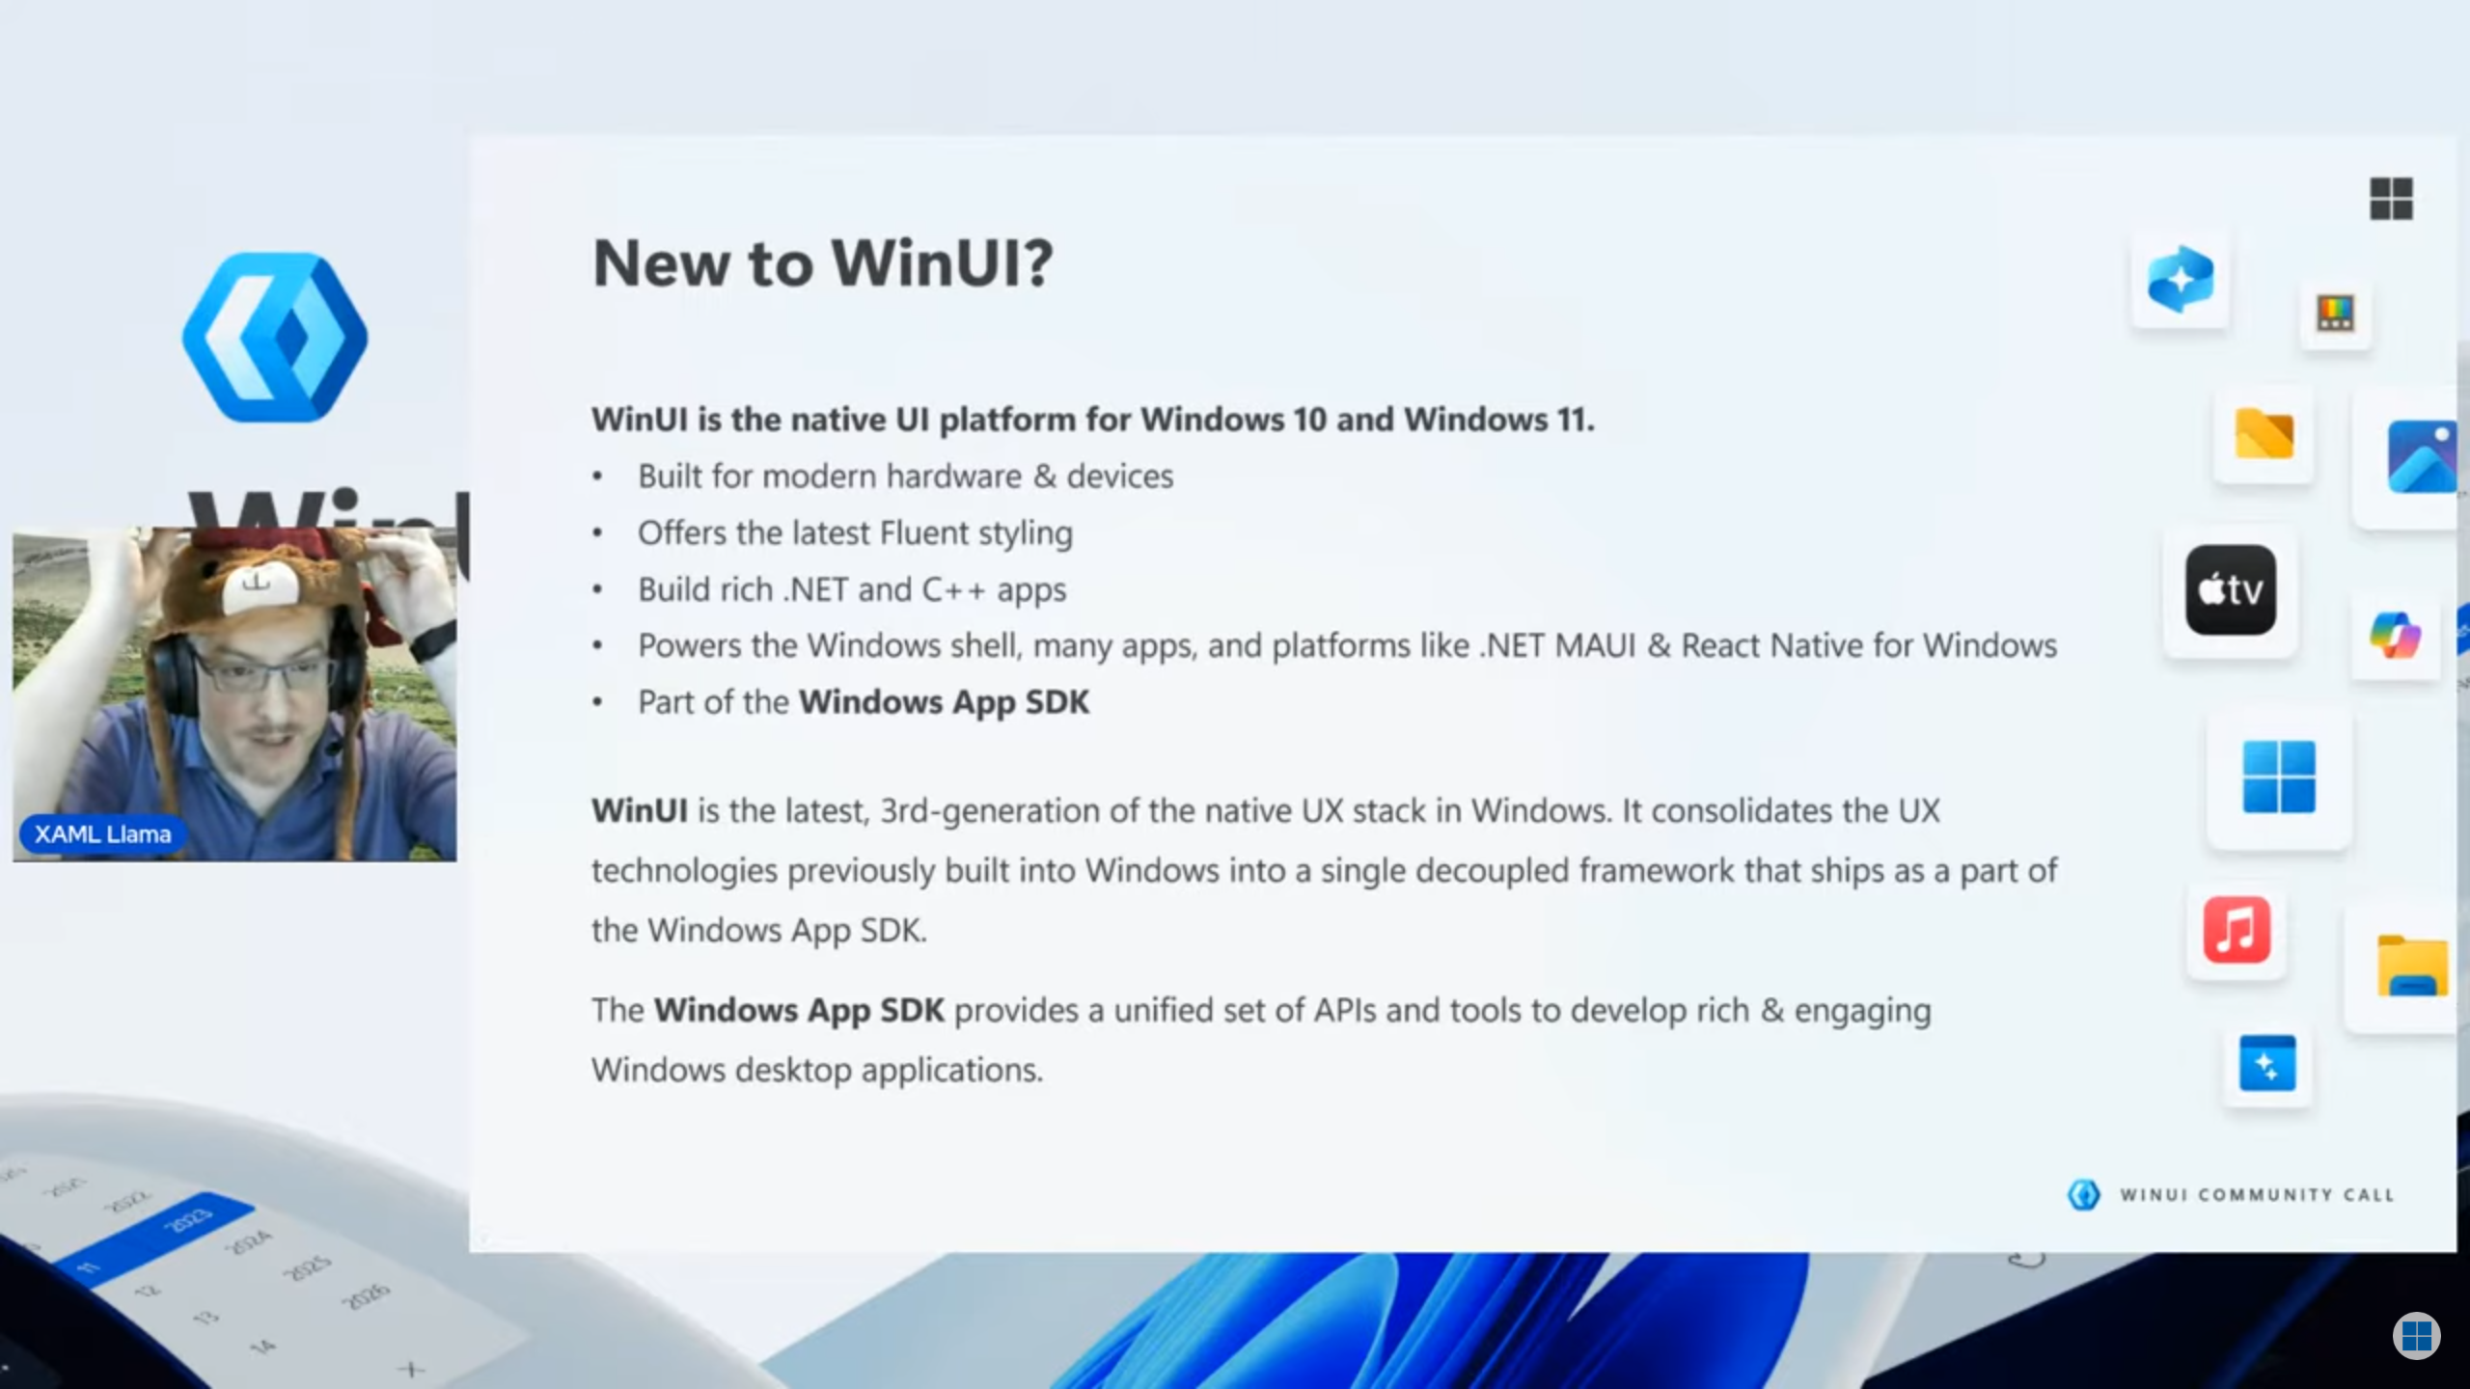
Community Calls on YouTube -> Windows Developer

Slide 12
03
AI for everyone w/ AI Dev Gallery

Slide 13
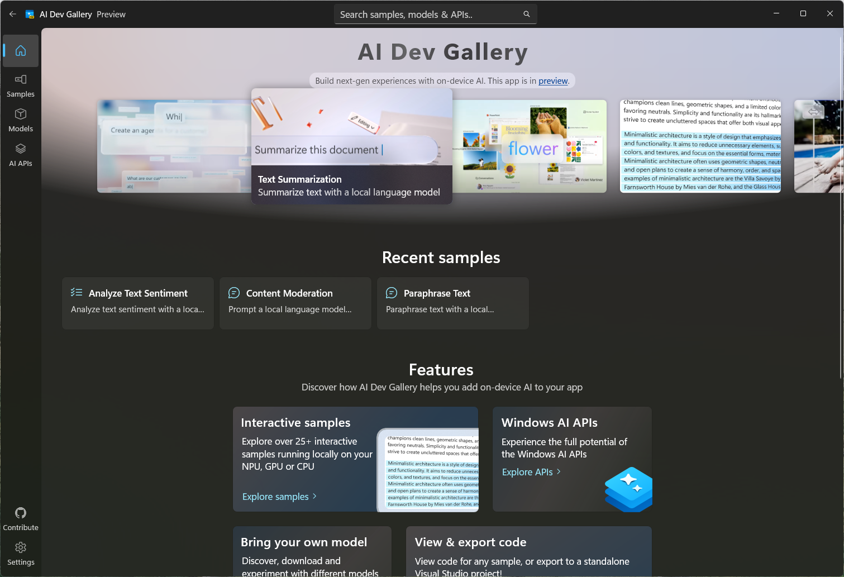
AI Dev Gallery
aka.ms/aidevgallery

Slide 14
04
Microsoft Foundry Local

Slide 15
Local AI Made Easy
Microsoft Foundry Local
Try it yourself!
Install with WinGet
https://github.com/ andrewleader/FoundryLocalLabDemo/
winget install Microsoft.FoundryLocal

Slide 16
05
WinAppSdk updates

Slide 17
WinAppSdk 2.0
Semantic versioning release schedule
Major
Minor
Patch
2.0.0, 3.0.0, 4.0.0
2.1.0, 2.2.0, 2.3.0
2.1.1, 2.2.2, 2.3.9
Yearly or with breaking change
Monthly with only additive updates
Bug / performance fixes

Slide 18
Pick and choose
NuGet Metapackage (A-la-carte)
App 1
App 2
App 3
Everything
UI + AI
Low level ML
Windows App SDK full package
WinUI3 + AI Foundry
Windows ML

Slide 19
Real world with meta packages
Windows AI APIs in C# app
Before meta packages
In WinAppSDK 1.8+
35.1 MB
18.7 MB
53.2% reduction!

Slide 20
Resources
Learn, build, do cool stuff with Windows
https://aka.ms/winappsdk
https://aka.ms/windev
https://aka.ms/winuigallery
https://aka.ms/windowstoolkitapp
https://github.com/ andrewleader/FoundryLocalLabDemo/
winget install Microsoft.FoundryLocal

Slide 21
Thank you

